Slide 1
Reinforcement
CE 544 – BRIGHAM YOUNG UNIVERSITY

Slide 2
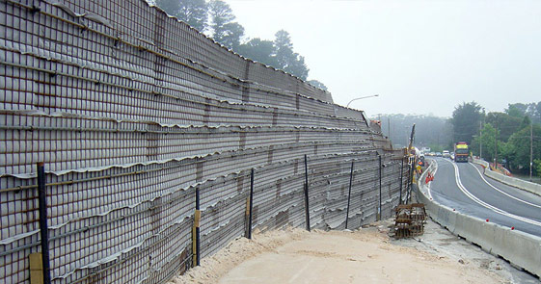
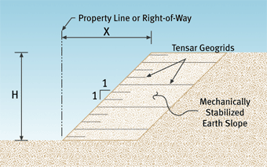
Applications
Reinforced soil walls or mechanically stabilized earth walls
Reinforced embankments on weak foundations
Anchored walls
Reinforced natural slopes (soil nails, piles, etc)

Slide 3
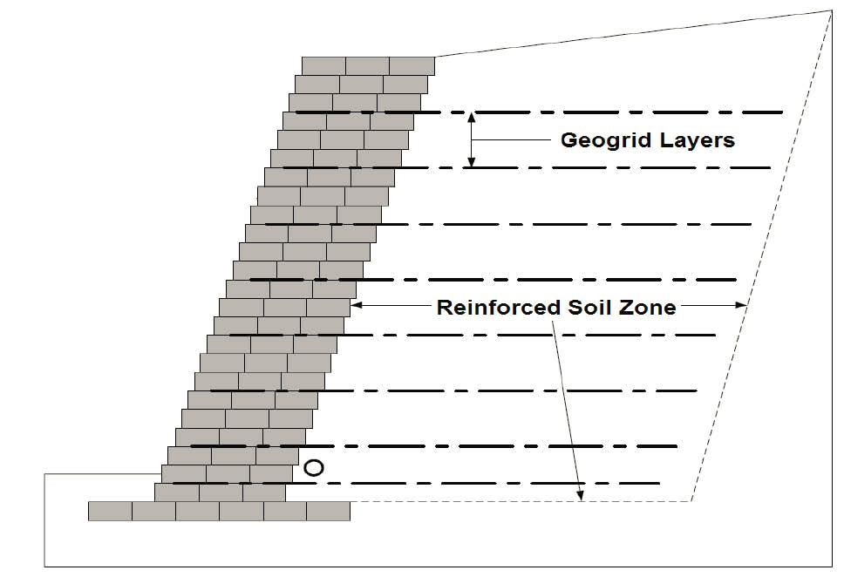
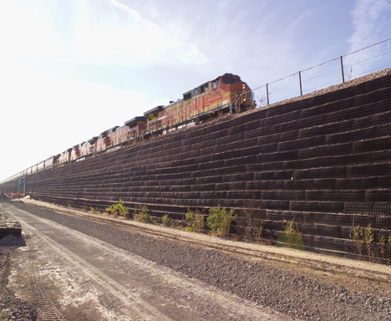
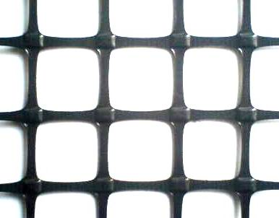
Geogrids

Slide 4

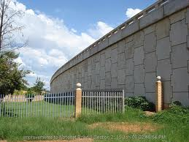
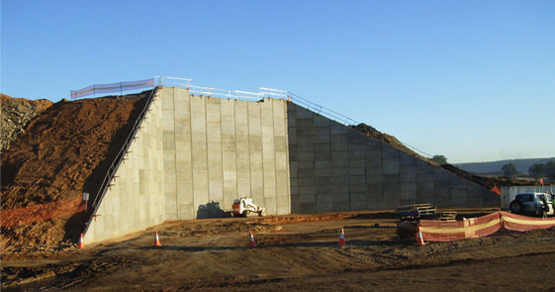
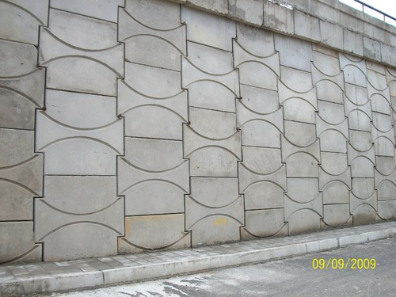
Reinforced Earth Walls

Slide 5
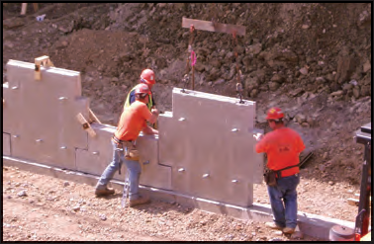
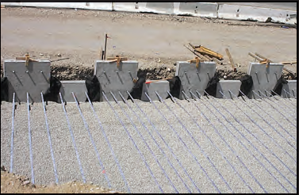
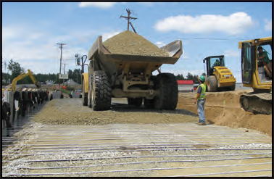
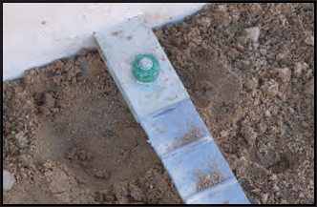
Steel Strip Anchorage

Slide 6
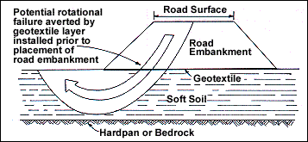
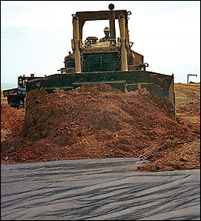
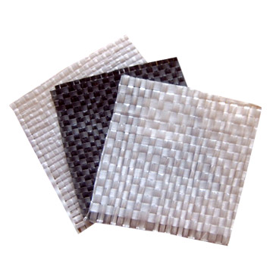
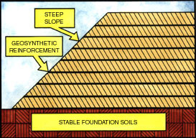
Geotextiles (woven)

Slide 7
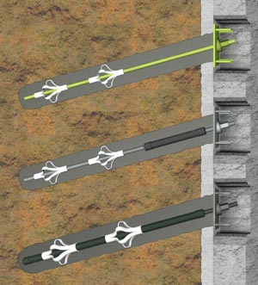
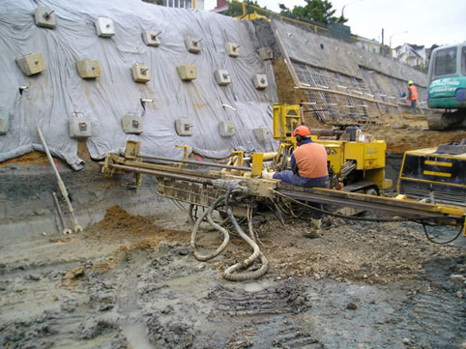
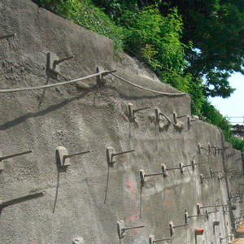
Soil Nails

Slide 8
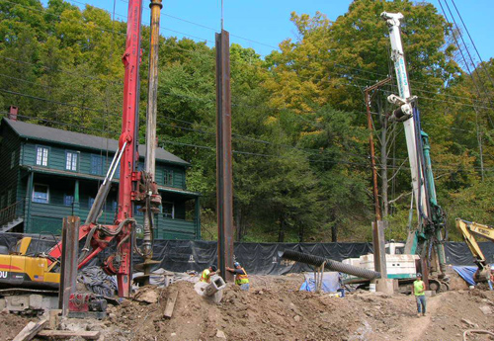
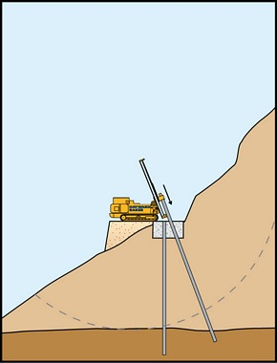
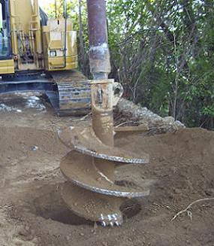
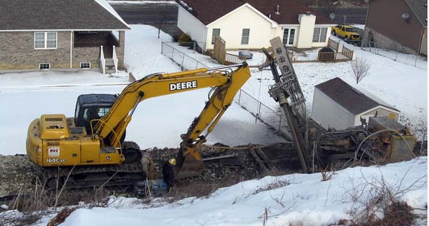
Piles/Drilled Piers

Slide 9
Analysis Methods

Slide 10
Reinforcement & the LE Method
Method A
The reinforcement forces used in the analysis are allowable forces and are not divided by the factor of safety
Only the soil strength is divided by FS
Method B
The reinforcement forces used in the analysis are ultimate forces and are divided by the factor of safety.
Both the soil and reinforcing force are divided by same factor of safety

Slide 11
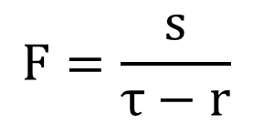
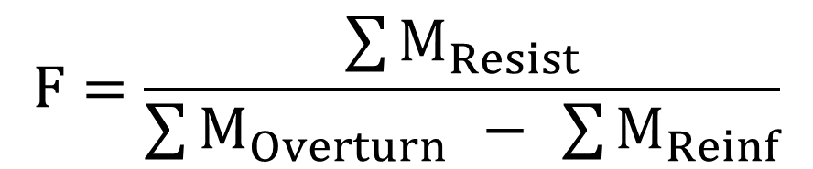
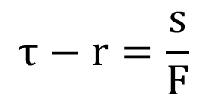
Method A Equations
For circular surfaces:
$$F=\frac{\sum{M_{Resist}}}{\sum{M_{Overturn}} − \sum{M_{Reinf}}}$$
General case:
$$F=\frac{s}{τ−r}$$
$$τ−r=\frac{s}{F}$$
I.e., the reinforcement resistance results in a reduction to the driving forces.
→
s = shear strength
τ = shear stress required for equilibrium
r = reinforcement resistance

Slide 12
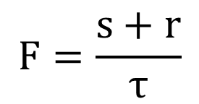
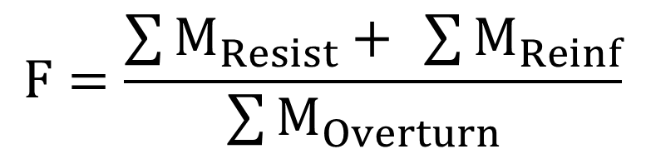
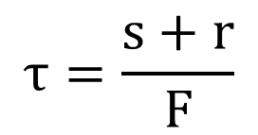
Method B Equations
For circular surfaces:
$$F=\frac{\sum{M_{Resist}+ \sum{M_{Reinf}}}}{\sum{M_{Overturn}} }$$
General case:
$$F=\frac{s+r}{τ}$$
$$τ=\frac{s+r}{F}$$
I.e., the reinforcement resistance results in an extra component of shear strength.
→
s = shear strength
τ = shear stress required for equilibrium
r = reinforcement resistance

Slide 13
Reinforcement & the LE Method
Method A is generally preferable because the soil and the reinforcement materials have different factors of safety and should be treated differently

Slide 14
Reinforcement Forces/Factors
Tensile strength
Creep
Installation damage
Durability
Pullout resistance
Stiffness and tolerable strain within the slope

Slide 15
Long-Term Capacity
T_{lim} = long term capacity
Must satisfy:
T_{lim} ≤ capacity determined by short-term tensile strength, creep, installation damage, and deterioration of properties over time
T_{lim} ≤ capacity determined by pullout resistance
T_{lim} ≤ capacity determined by stiffness and tolerable strain

